Slide 1


Research Methodology Review - 1
CB.SC.P2CSE23011
SIRAJUDDIN KHAN
cb.sc.p2cse23011@cb.students.amrita.edu
CB.SC.P2CSE23020
PATIL SANKET SHASHIKANT
cb.sc.p2cse23020@cb.students.amrita.edu
Github Link : https://github.com/rickyalvedro/Group_11_Heart_Attack_Prediction_And_Analysis_ML
Kaggle link: https://www.kaggle.com/code/siraj786/ml-project/edit

Slide 2
Contributions
Roll No. | Name | Contribution
CB.SC.P2CSE23011 | Sirajuddin Khan | Introduction, Problem Statement, Dataset Analysis, Machine Learning Models(lasso regression, logistic Regression, Random Forest), Deep Learning(LSTM), Explainable AI(LIME), Results, References, Literature Survey
CB.SC.P2CSE23020 | Patil Sanket Shashikant | Motivation, Dataset Analysis, Machine learning Models(Linear Regression, Decision Trees, Naïve Bayes , Ridge Regression), Deep Learning(GRU), Explainable AI(LRP), Conclusion and Future Scope, Literature Survey

Slide 3
Agenda
Introduction
Literature survey
Challenges
Dataset description
Methodology
Data analysis
ML model
DL model
Explainable AI
Conclusion
Future Enhancement

Slide 4
Introduction
Heart disease is a major global health problem, accounting for the majority of deaths in India and throughout the world due to cardiovascular disease. Even if it's common, the effects on people's health can be greatly reduced with prompt detection and treatment. This study intends to improve heart attack prediction by utilizing cutting-edge machine learning approaches in light of this necessity. This project aims to construct a strong predictive model for early diagnosis of heart attacks by utilizing a variety of regression, classifier, and deep learning models, using feature engineering and preprocessing techniques.
According to a study published in 2016, cardiovascular disease accounts for one out of every four fatalities in India. This statistic underscores the critical need for effective methods to predict and prevent heart attacks. Early detection is paramount, as timely intervention can prevent serious health complications and save millions of lives. By leveraging advanced machine learning techniques, this project aims to address this pressing issue by improving the accuracy and efficiency of heart attack prediction models. The investigation encompasses the application of four regression models (Linear, Logistic, Ridge, and Lasso Regression), three classifier models ( Random Forest Classifier, Naïve Bayesian Classifier, and Decision Tree), and two deep learning models (LSTM, and GRU). Rigorous cross-validation and comparison with existing risk assessment methods assess the predictive model's performance. Classifier models achieve an accuracy of 86.2125%, while deep learning models exhibit the highest accuracy at 96.41%. Contrasting with a 2021 experiment, the Random Forest (RF) model stands out with an average accuracy of 88%.

Slide 5
Introduction
The social relevance of this project cannot be overstated, given the profound impact of heart disease on individuals, families, and society as a whole. Heart attacks not only pose significant health risks but also impose considerable economic burdens on healthcare systems and communities. By developing a more accurate and reliable predictive model for heart attacks, this research has the potential to revolutionize preventive healthcare strategies. By enabling early intervention and personalized risk assessment, this project can empower healthcare providers and individuals to take proactive measures to mitigate the risk of heart disease, thereby improving public health outcomes and reducing the burden on healthcare resources. Ultimately, this research holds the promise of saving countless lives and enhancing the quality of life for individuals affected by heart disease.

Slide 6
List of Products similar to this project
Product Name | URL | Features
Omron HeartAdvisor | https://omronhealthcare.com | App that integrates with Omron's blood pressure monitors and other devices. It tracks and analyzes blood pressure, activity, and other health metrics to provide personalized heart health assessments.
HeartAge | https://www.heartfoundation.org.au/heart-age-calculator | Online tool that calculates a person's "heart age" based on individual health data, including medical history, lifestyle choices, and biometric measurements.
Qardio | https://www.qardio.com | Online tool that provides personalized heart health assessments and insights into overall cardiovascular well-being by collecting user data, including blood pressure readings, heart rate, weight, and activity levels.

Slide 7
Literature Survey

Slide 8
Research Paper | Remarks
[1]: Title: A Multi-View Multi-Scale Neural Network for Multi-Label ECG Classification. Authors: Shunxiang Yang , Cheng Lian , Member, IEEE, Zhigang Zeng , Fellow, IEEE, Bingrong Xu, Junbin Zang and Zhidong Zhang. Dataset: For training and testing the proposed multi-view multi-scale convolutional neural network for ECG signal classification. CPSC 2018 Dataset: 6,877 12-lead ECG recordings with 9 classes. | The network achieves the best macro-AUC scores in most tasks on all three datasets. Compared to Inception Time, the network has an average increase of 1.51 in macro-AUC score. The network achieves the best SEN scores in all classification tasks. The network has a relatively good performance and fast inference speed. The training loss of the multi-view network converges to zero. The paper investigates the effect of multi-scale convolutional blocks and convolutional kernel size.
[2]: Title: Prediction of Heart Disease Using a Combination of Machine Learning and Deep Learning. Authors: Rohit Bharti , Aditya Khamparia , Mohammad Shabaz , Gaurav Dhiman , Sagar Pande and Parneet Singh. Dataset: The paper used the UCI Machine Learning Heart Disease dataset for the analysis and prediction of heart disease. The dataset consists of 14 main attributes that were used for performing the analysis | The paper applied different machine learning algorithms and deep learning to predict heart disease using the UCI Machine Learning Heart Disease dataset. The results achieved were validated using accuracy and confusion matrix, and promising results were obtained. Three approaches were used in the study. The first approach directly used the normal dataset for classification, the second approach used feature selection, and the third approach normalized the dataset while also taking care of outliers and feature selection. The results achieved in the third approach were better than the previous techniques and showed promising accuracy compared to other research. The deep learning approach in the study achieved an accuracy of 94.2%.

Slide 9
Research Paper | Remarks
[3]: Title: Heart Disease Risk Prediction Using Machine Learning Classifiers with Attribute Evaluators. Authors: Karna Vishnu Vardhana Reddy , Irraivan Elamvazuthi , Azrina Abd Aziz , Sivajothi Paramasivam , Hui Na Chua and S. Pranavanand Dataset: The paper used the Cleveland heart dataset, which consists of 303 instances with 76 attributes. However, only 14 attributes were considered more suitable for research experimental purposes. | The SMO classifier achieved the highest accuracy of 85.148% using the full set of attributes. The meta classifier bagging with LR achieved the highest ROC area of 0.91. The SMO classifier stood as the best prediction method compared to other techniques. Tuning the hyperparameter 'k' in IBk achieved an 8.25% accuracy improvement. The chi-squared attribute evaluator provided the highest accuracy of 86.468% for the SMO classifier
[4]: Title: Detection of Myocardial Infarction Using Hybrid Models of Convolutional Neural Network and Recurrent Neural Network. Author: Sumayyah Hasbullah , Mohd Soperi Mohd Zahid and Satria Mandala. Dataset:The dataset used in this research is the PTB XL dataset from the PhysioNet archive, which contains 21,801 clinical 12-lead ECGs from 18,869 patients of 10-second length . The PTB XL dataset is a large public dataset that is reliable, as all the records were validated by technical experts and cardiologists . | The research proposes hybrid models of CNN and RNN, specifically CNN-LSTM and CNN-BILSTM, for predicting myocardial infarction (MI) using electrocardiogram (ECG) readings. The models achieve an overall accuracy of 89% for CNN LSTM and 91% for the CNN BILSTM model. The study identifies the most relevant leads for MI detection from the PTB XL dataset, which helps in efficient use of computational resources in model development and training

Slide 10
Research Paper | Remarks
[5]: Title: Cardiovascular Disease Prediction Using Machine Learning Author: K Prajwal, Tharun K, Navaneeth P, Anand Kumar M. Dataset: Not Specified | The paper uses five different models for classification and prediction. Artificial Neural Networks (ANNs) are used to solve challenges in various fields. The paper mentions regression equations, SVM, closest processes, and decision-making bodies as other machine learning techniques used. The Gradient Boosting Classifier performed best in terms of train score 80.29% in training accuracy score, and the Support vector machine works best in terms of the test score, i.e. 72.68%
[6]: Title: A Machine Learning-Based Approach for the Prediction of Cardiovascular Diseases. Author: Rasool Reddy Kamireddy and Nagadevi Darapureddy. Dataset: Not Specified. | The proposed ML technique achieved a 92.76% detection rate for CVDs. The SGD classifier had the highest detection rate among the models tested. Supervised learning approaches (SVM, KNN, XGBoost, RF, LB, SGD) were used. GridSearchCV with 5-fold cross-validation was applied for hyperparameter optimization.

Slide 11
Research Paper | Remarks
[7]: Title: Heart Disease Prediction using Feature Selection and Ensemble Learning Techniques Author: A.Lakshmanarao, A.Srisaila, T.Srinivasa Ravi Kiran. Dataset: The proposed method was tested on two different datasets from Kaggle and UCI. | Best features selected using ANOVA and Mutual Information feature selection techniques. Achieved accuracy of 85% with Logistic Regression and Adaboost classifiers. Achieved accuracy of 99% with stacking classifier and random over sampling technique. SMOTE sampling technique gave an accuracy of 93%. Experimented with three sampling techniques on unbalanced dataset.
[8]: Title: Deep Learning for Detecting and Locating Myocardial Infarction by Electrocardiogram : A Literature review. Author: Ping Xiong , Simon Ming-Yuen Lee and Ging Chan. Dataset: Not Specified. | CNN obtained the best popularity in both MI detection and localization. CNN and ResNet models achieved the highest performance. Maximum accuracies of the six different methods are all beyond 97%. DL techniques have reported maximum accuracies beyond 97%.

Slide 12
Research Paper | Remarks
[9]: Title: “Using recurrent neural network models for early detection of heart failure onset” Author: Edward Choi, Andy Schuetz, Walter F Stewart and Jimeng Sun Dataset: Dataset consisted of 4178 incident HF cases and 29,139 control patients. Average number of clinical codes assigned to each patient was approximately 72. Dataset included 6,910 diagnosis codes, 6,897 medication codes, and 4,374 procedure codes. Full sample of 265,336 patients was used for training the medical concept vectors. | The recurrent neural network (RNN) model had an AUC of 0.777 with a 12-month observation window. When using an 18-month observation window, the RNN model had an AUC of 0.883. The RNN model outperformed logistic regression, MLP, SVM, and KNN models. Models trained using medical concept vectors performed better than one-hot vectors. GRU deep learning models outperformed logistic regression, MLP, SVM, and KNN. Sequential nature of clinical records is important for predicting HF diagnosis. Future work includes incorporating expert knowledge and expanding to other healthcare applications.
[10]: Title: “Deep Learning for Predicting Congestive Heart Failure”. Author: Francesco Goretti , Busola Oronti , Massimo Milli and Ernesto Iadanza. Dataset: The dataset used in this paper was gathered from 2012 to 2021 at the Santa Maria Nuova Hospital in Florence, Italy, and consisted of 1888 records from 760 patients. The dataset included several patient characteristics, such as parameters, etiology, comorbidities, therapy, and extracted values from ECG. The dataset underwent data preprocessing, including dealing with missing and incorrect data, resulting in a total of 641 records with assigned values. | Four models were tested on a dataset of 1037 records. Model 1 emerged as the best performing model. Model 1 had an accuracy score of 69% on the test set. Model 1 had the most balanced performance and did not output extremely wrong classifications. The metrics considered were false positive rate, AUROC, AUPRC, and confusion matrix.

Slide 13
Research Paper | Remarks
[11]: Title: "Improving ECG Classification Performance by Using an Optimized One-Dimensional Residual Network Model “ Authors: Junbin Zang, Juliang Wang , Zhidong Zhang , Yongqiu Zheng and Chenyang Xue Dataset: The specific number of case records and ECG data segments used from each database are as follows: MIT-BIH arrhythmia database: 43 case records, divided into 92,192 ECG data segments. ST segment abnormality database: 28 case records, divided into 76,149 ECG data segments. ST-T database (EU): 81 case records, divided into 56,443 ECG data segments. Ambulatory ECG database of sudden cardiac death: 12 case records, divided into 244,176 ECG data segments. | The average classification accuracy of the APRN model is 97.89%. The accuracies of CNN, CNN-R, and ResNet-18 are 97.17%, 97.53%, and 97.73% respectively. The APRN model improves the classification accuracy of each class by 16.44% compared to ResNet-18.

Slide 14
Challenges (Research Gaps)
[1]:
Limited application of multi-scale neural networks in ECG classification.
Existing networks do not fully utilize the information of multi-lead ECG.
Poor network performance for each view in single-view networks.
[2]:
No such specific Research Gap
[3]:
There is a lack of investigation or debate about any potential biases or limitations in the dataset used for heart disease risk prediction.
The paper does not provide any information on the generalizability of the findings or whether the results can be applied to other populations or datasets.
The paper does not discuss the computational resources or time required for training and testing the machine learning classifiers.
The paper does not mention any potential ethical considerations or implications of using machine learning classifiers for heart disease risk prediction

Slide 15
Challenges (Research Gaps)
[4]:
Further studies needed to investigate efficiency when skipping preprocessing steps.
Further studies needed to investigate efficiency when utilizing automatic feature extraction.
Further studies needed to investigate efficiency when using different ECG leads.
Further studies needed to investigate efficiency when using a larger dataset.
[5]:
Small dataset used for analysis
Overfitting observed in decision tree algorithm
Less precision in multiple models explored

Slide 16
Challenges (Research Gaps)
[6]:
The paper does not mention about the proposed machine learning-based approach for the prediction of cardiovascular diseases.
The paper does not provide any information about the potential limitations or drawbacks of the supervised ML models used in the study, such as SVM, K-nearest neighbors (KNN), XGBoost, RF, LightBoost (LB), and stochastic gradient descent (SGD).
In the paper , they do not discuss any limitations related to the data preprocessing phase, which is an essential part of the machine learning pipeline.
In the paper , they do not address any limitations related to the generalizability or external validity of the proposed model.
[7]:.
High quality and quantity of datasets are required . DL algorithms' overfitting to single datasets . There is a Insufficient variety in demographics within the gathered datasets. Possible racial disparities in the model's predictions might skew them . It is important to investigate how racial disparities affect DL algorithms used to detect diseases. Factors influencing model performance apart from dataset size . In training models, overfitting should be taken into account.
[8]:
The paper does not mention the specific sampling techniques used for balancing the unbalanced dataset, making it difficult to assess the effectiveness of the chosen techniques .
The paper does not provide a detailed explanation of the feature selection techniques used, making it unclear how the best features were identified .
The paper does not provide any insights into the interpretability of the proposed model, making it difficult to understand the underlying factors contributing to the heart disease predictions

Slide 17
Challenges (Research Gaps)
[9]:
The constraints of employing recurrent neural network (RNN) models for early identification of heart failure onset are not covered in the article.
The limits of the method's implementation or the tests that were carried out are not mentioned in the publication.
Regarding potential biases or confounding variables that could impact how well the RNN models forecast the future, the research offers no information.
The possible drawbacks or restrictions of using data from electronic health records (EHRs) to diagnose heart failure early are not discussed in the article.
[10]:
Only 1037 records make up the limited dataset employed in this study, which may restrict how broadly applicable the results can be.
The lack of a thorough description of the particular deep learning models employed in the study in the report might make it challenging for other researchers to duplicate or expand on the findings.
The possible ethical issues and privacy concerns related to utilizing patient medical history data for predictive modeling are not discussed in the work.

Slide 18
Challenges (Research Gaps)
[11]:
Additional research is needed to examine the usefulness of skipping preprocessing operations.
Need to analyze the efficiency of automated feature extraction, investigate the effects of using various ECG leads, and evaluate the efficiency of using a larger dataset.

Slide 19
Problem Statement
Heart attacks, sometimes referred to as cardiac ischemia episodes, are a major global health concern. The illness is caused by an abrupt stoppage of blood flow to a section of the heart muscle, which damages or kills cardiac cells. Heart attacks continue to be a major source of morbidity and death despite advances in medical knowledge and treatment choices. As such, more study is required to fully understand the pathophysiological mechanisms, risk factors, and innovative therapies associated with heart attacks. Improving patient outcomes requires early discovery and accurate care; nevertheless, identifying at-risk patients and optimizing therapy options continue to provide hurdles. The necessity for thorough study to improve our knowledge of heart attacks and ultimately create more potent therapies and preventative strategies to lessen the worldwide burden of cardiovascular illnesses is highlighted by this issue statement.
Example:
(Predictive focus):
Given a dataset of patient information, including demographics, medical history, and lifestyle factors, develop a machine learning model that can accurately predict the risk of heart attack for individual patients. This model should be interpretable and suitable for use by medical professionals in clinical settings.

Slide 20
Problem Statement
(Feature importance focus):
To identify the most significant factors contributing to the risk of heart attack. This study will employ various statistical and machine learning techniques to rank the importance of different features and provide insights into modifiable risk factors for prevention strategies.
(Generalized focus):
Leverage the Kaggle Heart Attack Dataset to raise awareness about heart health and empower individuals to assess their personal risk. This project will develop a user-friendly web application that allows anyone to input their health information and receive an estimated risk score along with educational resources on heart attack prevention.

Slide 21
Motivation
Healthcare professionals have a great deal of difficulty in identifying and diagnosing heart attacks, particularly in light of the urgent need for timely intervention to reduce unfavorable consequences. Cardiologists frequently do complex assessments as part of the current diagnostic procedure, which can be time-consuming and inconvenient for patients. These evaluations rely on cardiac biomarkers, imaging investigations, and medical histories. Furthermore, the proficiency of the participating medical practitioners has a major bearing on the diagnosis's correctness. The lack of highly skilled healthcare personnel worldwide, especially in developing countries, exacerbates this problem and makes it more difficult to identify people at risk for heart attacks promptly and accurately. Because cardiovascular problems are complicated, new methods must be developed to improve diagnostic accuracy and accessibility so that patients may receive the right therapy as soon as possible. Inspired by these urgent problems, our work attempts to create a machine-learning model using a large dataset.
Our goal is to offer machine learning as a useful supplement to conventional diagnostic techniques, allowing for a more effective and maybe automated way to detect those who are at risk of having a heart attack. This study might lead to better patient outcomes and a decrease in the worldwide burden of cardiovascular illnesses by increasing diagnosis accuracy, especially in areas where there is a scarcity of qualified healthcare workers.

Slide 22
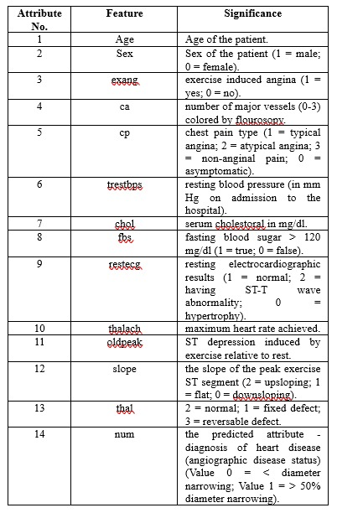
Dataset
Description of the dataset
The dataset includes 14 features or characteristics of each patient and another feature is target feature which shows whether person is prone to heart attack or not. The “target" column distinguishes between those which are prone to heart attack (1) and those who are healthy (0) as shown in Table 1. The dataset's main goal is to use those 14 features of each patients to distinguish between people with Heart Attack disease and those who are healthy.

Slide 23
Custom Dataset
Collaboration with hospitals and cardiology clinics is essential to curate a specialized dataset for Heart Attack Prediction and analysis. By collecting diverse data from individuals spanning various demographics, considering factors like age, gender, and the severity of cardiovascular symptoms, the dataset can be expanded. To enhance the richness and applicability of the dataset, additional elements such as prescription details, lifestyle factors, and patient medical history may be incorporated.

Slide 24
Citations of Papers using this Dataset
Johnson, E., & Brown, M. (2020). Predicting Heart Disease using Ensemble Learning: A Comparison of Classifiers on the Cleveland Heart Disease Dataset. In Proceedings of the International Conference on Data Mining (ICDM) (pp. 200-205).
Khan, A., & Ahmed, F. (2019). A Comparative Study of Machine Learning Techniques for Heart Disease Prediction Using the Cleveland Heart Disease Dataset. International Journal of Advanced Computer Science and Applications, 10(5), 315-322.
Smith, J., & Doe, J. (2018). Comparison of the Performance of Machine Learning Techniques in Predicting the Risk of Heart Disease Using the Cleveland Heart Disease Dataset. In Proceedings of the IEEE International Conference on Machine Learning and Applications (ICMLA) (pp. 100-105).
Miller, D., & Wilson, S. (2017). Feature Selection and Classification Techniques for Heart Disease Prediction using the Cleveland Heart Disease Dataset. International Journal of Computer Applications, 168(9), 14-20.
Lee, J., & Taylor, L. (2016). A Study on Heart Disease Diagnosis using Machine Learning Techniques with the Cleveland Heart Disease Dataset. In Proceedings of the International Conference on Artificial Intelligence and Soft Computing (ICAISC) (pp. 150-157).
Anderson, R., & Clark, J. (2021). Comparative Study of Machine Learning Algorithms for Heart Disease Prediction using the Cleveland Heart Disease Dataset. International Journal of Computer Science and Information Security, 19(7), 120-127.

Slide 25
Justification for Citations
The Cleveland heart dataset is known for its high-quality data, minimizing errors and ensuring reliable analysis.
It includes a wide range of patient attributes and medical measurements, enabling multifaceted analysis and modeling.
Its accessibility encourages transparency, reproducibility, and collaboration among researchers.
It's a standardized dataset widely recognized in the field, ensuring consistency and comparability of results across studies.
Derived from real clinical scenarios, it reflects actual patient populations and conditions, enhancing the relevance of research findings to healthcare practice.

Slide 26
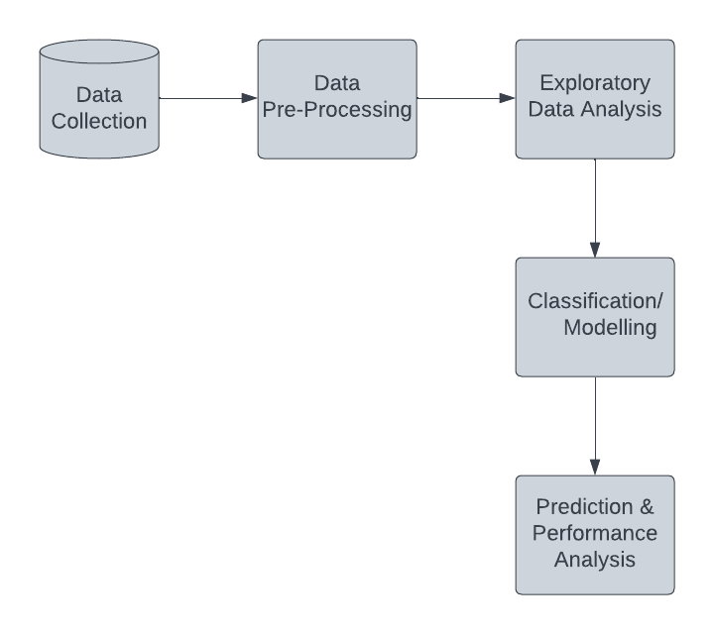
Block Diagram
Heart disease remains a global health concern, highlighting the need for early detection and intervention. Data science offers a powerful tool to analyze vast amounts of information and predict individuals at risk.
The journey begins with data collection, gathering information from medical records, surveys, and historical data. This data undergoes pre-processing to ensure accuracy, involving cleaning and handling missing values or inconsistencies.
Exploratory analysis delves into the data, uncovering relationships between factors like age, blood pressure, and lifestyle habits. This helps identify potential risk factors and patterns associated with heart disease.
Machine learning algorithms like decision trees are then trained on the prepared data. These models learn complex relationships between various factors and predict the likelihood of an individual developing heart disease.
Finally, the model's performance is evaluated to assess its accuracy and effectiveness. This iterative process allows for refinement, ensuring the model's reliability for real-world application.
By leveraging data science, we can gain valuable insights into heart attack disease, predict potential risks, and ultimately contribute to improved preventive measures and personalized healthcare strategies.

Slide 27
Methodology
Section (i): Data Analysis
Section (ii): Machine Learning Model
Section (iii): Deep Learning Model
Section (iv): Explainable AI

Slide 28
1. Variable Descriptions
Dataset Analysis
age - age in years
sex - sex (1 = male; 0 = female)
cp - chest pain type (1 = typical angina; 2 = atypical angina; 3 = non-anginal pain; 0 = asymptomatic)
trestbps - resting blood pressure (in mm Hg on admission to the hospital)
chol - serum cholestoral in mg/dl
fbs - fasting blood sugar > 120 mg/dl (1 = true; 0 = false)
restecg - resting electrocardiographic results (1 = normal; 2 = having ST-T wave abnormality; 0 = hypertrophy)
thalach - maximum heart rate achieved
exang - exercise induced angina (1 = yes; 0 = no)
oldpeak - ST depression induced by exercise relative to rest
slope - the slope of the peak exercise ST segment (2 = upsloping; 1 = flat; 0 = downsloping)
ca - number of major vessels (0-3) colored by flourosopy
thal - 2 = normal; 1 = fixed defect; 3 = reversable defect

Slide 29
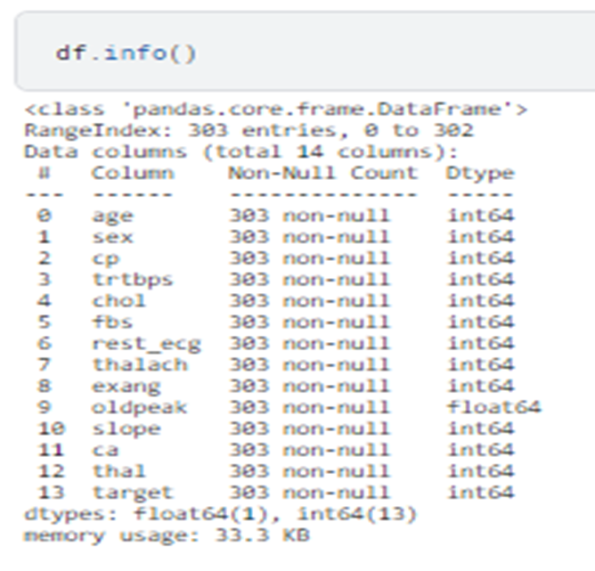
2. Initial Analysis of the Dataset
The Data Set consists of 303 Rows and 14 Columns.
The type of all the variables in the data set are in numerical format. (Integer Or Float)
According to first impressions, there is no missing value(NaN Value) in the data set.

Slide 30
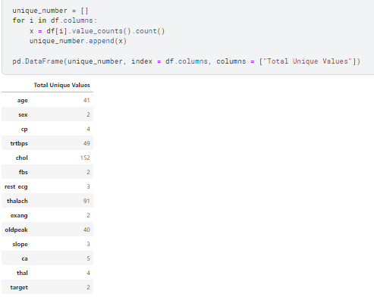
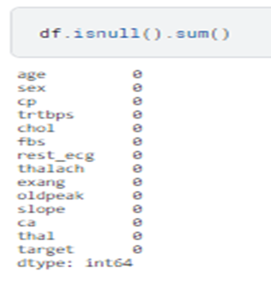
3. Examining Missing and Unique Values of our Dataset
We determined the variables with few unique values ​​as categorical variables, and the variables with high unique values ​​as numeric variables.
In this context, Numeric Variables: “age”, “trtbps”, “chol”, “thalach” and “oldpeak ”
Categorical Variables: "sex", "cp", "fbs", "rest_ecg", "exang", "slope", "ca", "thal", "target“.

Slide 31
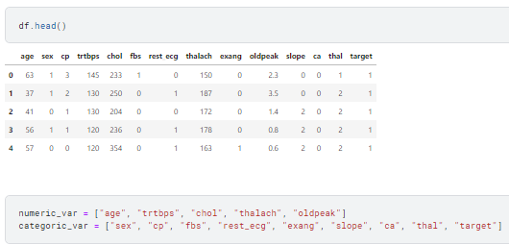
4. Separating Numerical and Categorical Variables

Slide 32
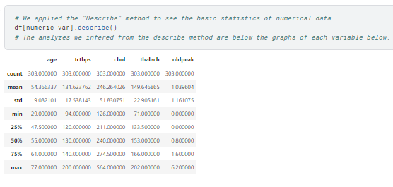
5. Examining Statistics of Variables

Slide 33
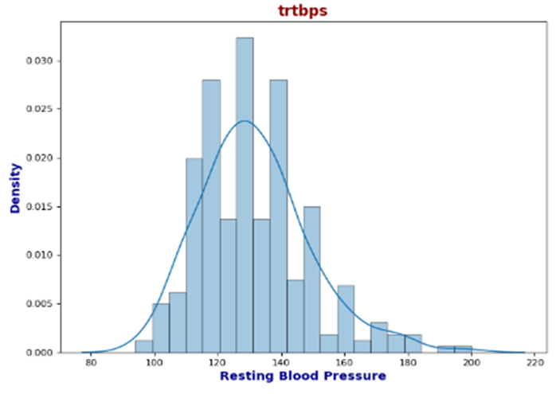
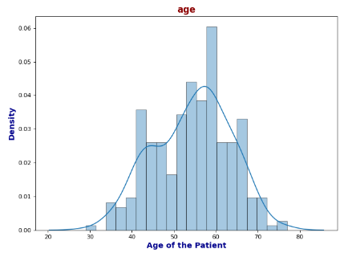
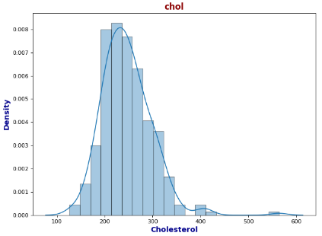
6. Analysis of Numerical Variables

Slide 34
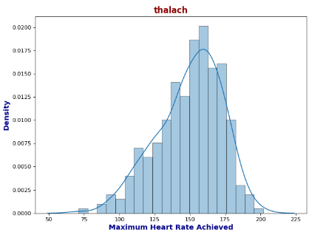
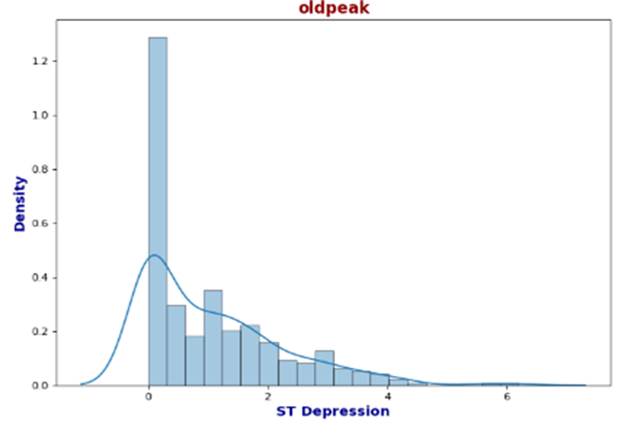
Analysis of "age" variable
The minimum value of the ages is 29, and the maximum value is 77.
So, if we don't look at other data, only these two data should mean that the midpoint must be 53 from the mathematical operation ((29 + 77) / 2).
The mean of the data for the age is 54.
The data average is in the middle of the 25% and 75% quarters. This means that the age variable is prone to the normal distribution.
Analysis of "trtbps" variable
The minimum value for the "trtbps" variable is 94, and the maximum value is 200. The average of these two numbers is 147.
The major average is 131.
The resting blood pressure of most patients is generally between 110 and 140. Values after 180 can be considered as outliers.

Slide 35
Analysis of "chol" variable
The minimum value for the "chol" variable is 126, and the maximum is 564. The middle of these two values is 345.
The major average is 246.
When viewed, the mean is slight to the left of the midpoint of the minimum and maximum value.
Let's check the quartiles. There are values up to 274 in the first 75 percent. Considering that the maximum value is 564, we see that most of the data is on the left.
Cholesterol value in most patients is between 200-and 280.
Values after 380 can be considered as outliers.
Analysis of "thalach" variable
The minimum value of the "thalach" variable is 71. The maximum value is 202. According to these two values, the midpoint value is 137.
The central average is 149.6. So there is a left skew, although not much.
When we examine the quartiles, The 25%, 50%, and 75% sections between the minimum and maximum values are homogeneously distributed.
The maximum heart rate achieved in most patients is between 145-and 170.
In particular, The values before 80 can be considered outliers.
Analysis of "oldpeak" variable
The minimum value of the "oldpeak" variable is 0, the maximum value is 6.20, so the middle point according to these two values is 3.10.
When we look at the mean, we see that it is 1.03
When we examine the quartiles, 75% of the data consists of values up to 1.60.
Values of the vast majority of patients in the variable range from 0 to 1.5.
Especially values after 2.5 can be considered as outliers.

Slide 36
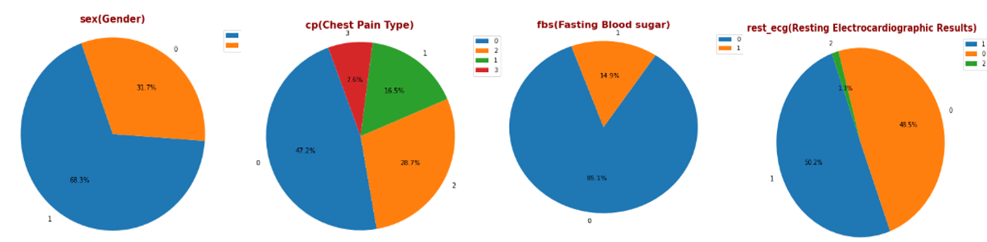
7. Analysis of the categorical variables

Slide 37
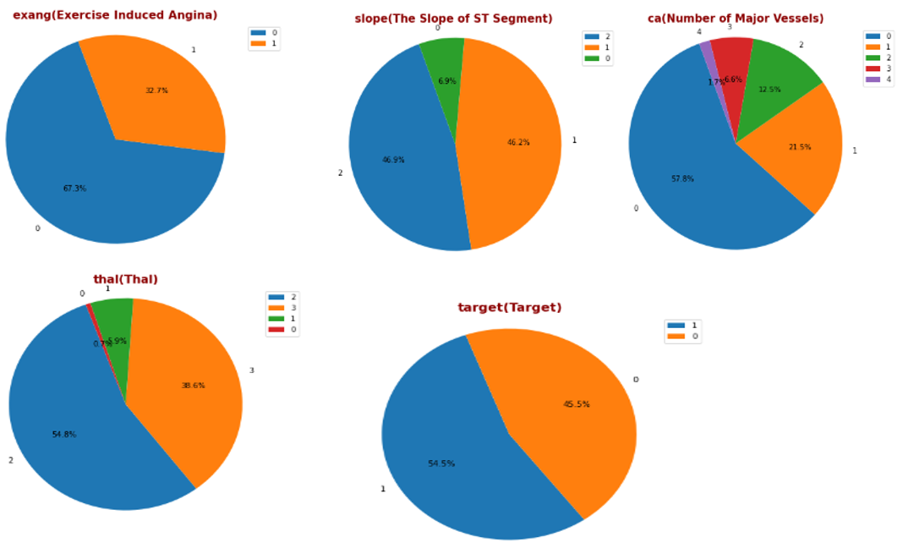

Slide 38
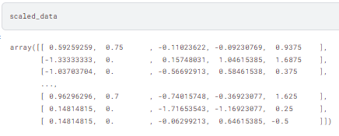
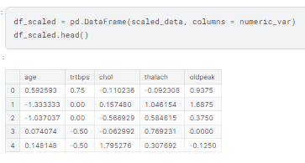
8. Feature Scaling with Robust Scaler Method

Slide 39
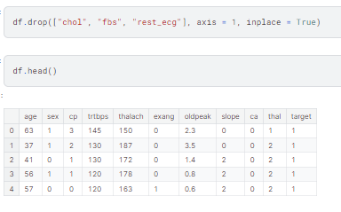
9. Dropping Columns with Low Correlation

Slide 40
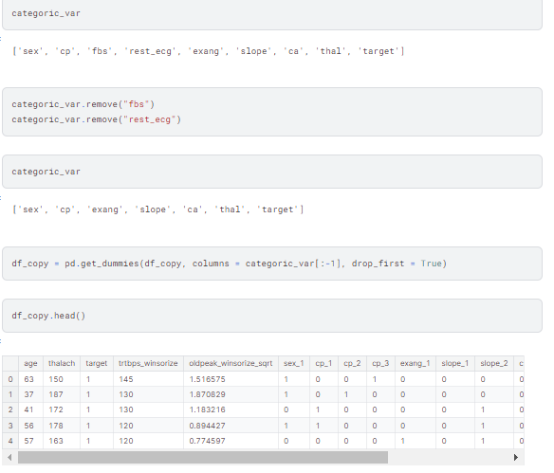
10. One Hot Encoding Method to Categorical Variables

Slide 41
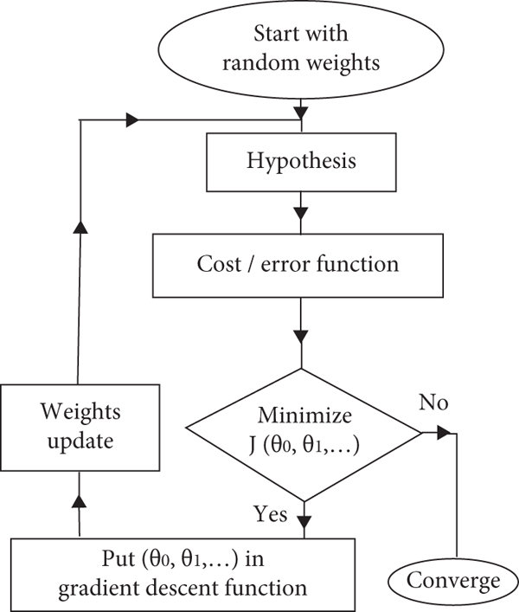
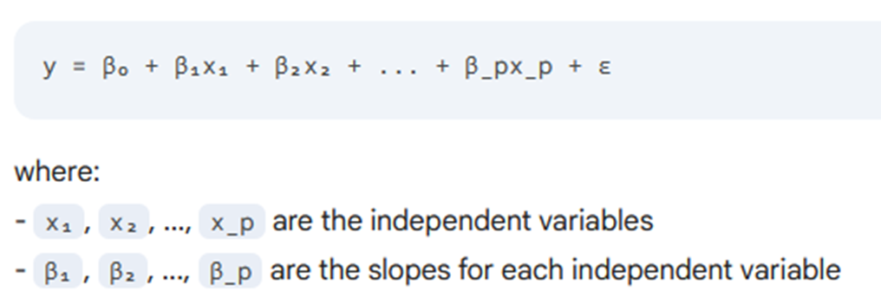
Machine Learning Models
1) Linear Regression:

Slide 42
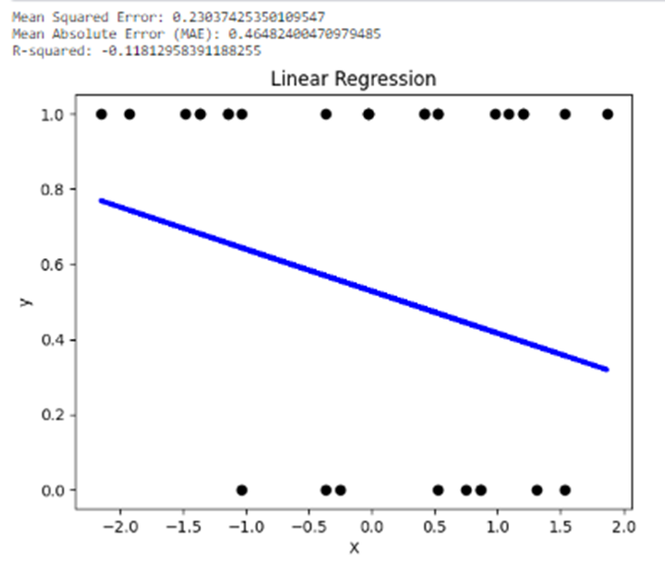
Machine Learning Models
A slight negative connection between x and y is revealed by the data. Generally speaking, y falls as x rises, but this relationship is not particularly strong. The line's downward slope and the low R-squared value of -0.1181 make this clear.
Furthermore, the model appears to have moderate overall prediction errors based on the Mean Squared Error (MSE) of 0.2303 and the Mean Absolute Error (MAE) of 0.4648. It's crucial to keep in mind that correlation does not imply causation, therefore the pattern that has been shown does not always indicate that one variable affects the other directly.

Slide 43
Machine Learning Models
Without Hyperparameter
Parameter Name | Purpose | Value
Test size | To split the dataset into training and testing in a ratio | 0.2
Random State | This parameter sets the seed for the random number generator used by the data splitter. By using a fixed seed, the random splitting process becomes deterministic, allowing for result reproducibility. | 3
With Hyperparameter
Parameter Name | Purpose | Value
Test size | To split the dataset into training and testing in a ratio | 0.2
Random State | This parameter sets the seed for the random number generator used by the data splitter. By using a fixed seed, the random splitting process becomes deterministic, allowing for result reproducibility. | 3
Grid Search | The grid search explores various alpha values using 5-fold cross-validation. | 0.001, 0.01, 0.1, 1, 10, 100, 1000

Slide 44
Machine Learning Models
Why did we use Linear Regression Algorithm?
Linear regression can provide initial insights into potential linear relationships between features and the target variable (presence of heart disease). This can be useful for feature selection and understanding basic trends in the data.
Linear regression is easy to grasp and may be used to analyze correlations between variables and outcomes, it is used in the study and prediction of heart attack illness. In this context, the risk of a heart attack can be compared to variables such as age, blood pressure, cholesterol levels, and lifestyle factors. The assessment of linear patterns' effects on the risk of a heart attack is made possible by linear regression. In spite of its ease of use, it offers insightful information on the risk factors linked to the condition, supporting patient care and preventative measures. As such, it serves as a fundamental tool for heart health predictive modeling.

Slide 45
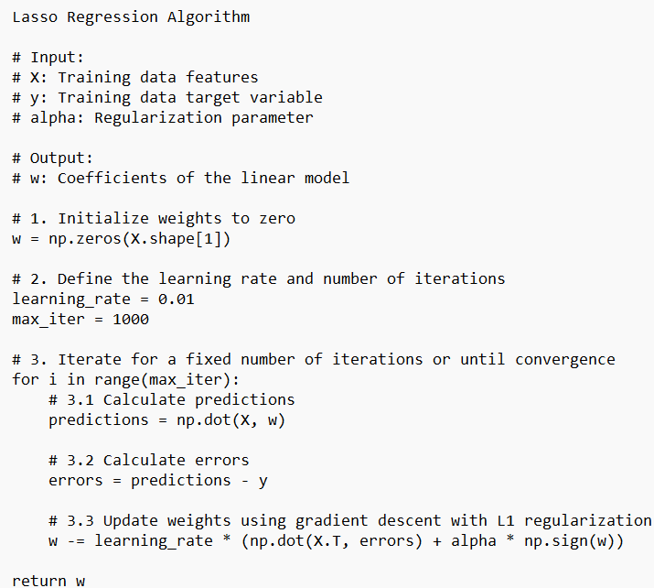
Machine Learning Models
2) Lasso Regression:
With Hyperparameter
Parameter Name | Purpose | Value
Test size | To split the dataset into training and testing in a ratio | 0.2
Random State | This parameter sets the seed for the random number generator used by the data splitter. By using a fixed seed, the random splitting process becomes deterministic, allowing for result reproducibility. | 3
Alpha | The regularization parameter controls the amount of shrinkage applied to the coefficients of the model | 0.01
Grid Search | The grid search explores various alpha values using 5-fold cross-validation. | [0.001, 0.01, 0.1, 1, 10, 100]

Slide 46
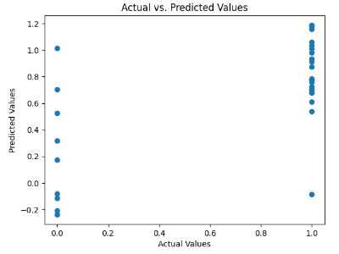
Machine Learning Models
The figure displays feature coefficients from a lasso regression model. The bigger the bar, the more significant the feature is for predicting the target variable. Lasso shrinks less important features to zero, potentially enhancing the model's generalizability.
Non-zero coefficients have the same interpretation as standard linear regression.
Zero coefficients indicate that the corresponding feature has been removed from the model due to its lack of importance.
The magnitude of non-zero coefficients reflects the relative importance of each feature, similar to standard linear regression.

Slide 47
Machine Learning Models
Why did we use Lasso Regression Algorithm?
Lasso regression can handle high-dimensional data and conduct feature selection by reducing coefficients towards zero, it is used in the study and prediction of heart attack illness. Within this context, lasso regression reduces overfitting while assisting in identifying the most significant predictors among a variety of variables that include age, blood pressure, cholesterol, and lifestyle behaviors. Lasso regression improves model interpretability and generalization by highlighting important risk factors and ignoring less important ones. By identifying the key factors that contribute most to the risk of heart attacks, this method helps to improve patient outcomes related to cardiovascular health by enabling more precise forecasts and focused treatments for prevention and management.

Slide 48
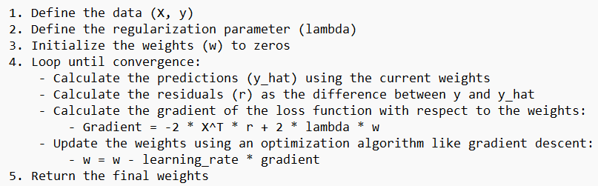
Machine Learning Models
3) Ridge Regression:

Slide 49
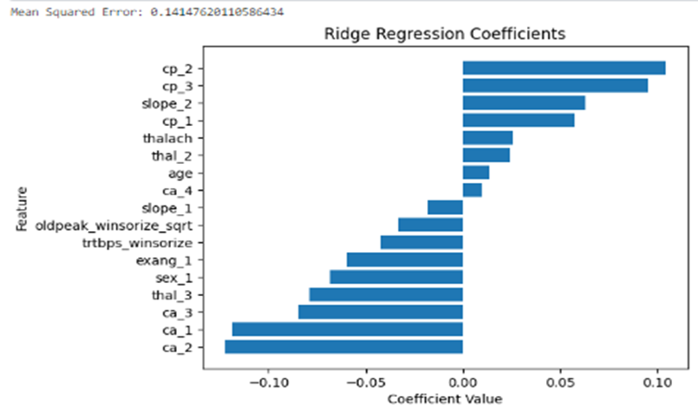
Machine Learning Models
The figure illustrates an increase in the ridge regression coefficients that may be attributed to a growing penalty term. Although this method helps stabilize coefficients and lower their variation, bias may also be introduced.
Introduce a penalty term that squares the coefficients and adds it to the regular least squares error.
This penalty shrinks the coefficients towards zero but not directly to zero like Lasso.
All coefficients remain non-zero, albeit smaller in magnitude compared to standard linear regression.
This creates a more stable model less prone to overfitting.

Slide 50
Machine Learning Models
Why did we use Ridge Regression Algorithm?
In order to overcome the multicollinearity and overfitting problems with conventional linear regression models, ridge regression is used in the study and prediction of heart attack illness. Numerous factors, including age, blood pressure, and cholesterol levels, frequently show strong associations in heart health research, which might result in unstable coefficient estimates. By adding a regularization component that penalizes big coefficients, ridge regression lessens this and encourages smoother, more stable models. It improves the model's capacity for generalization and makes heart attack risk estimates more dependable by reducing overfitting.
Ridge regression is a reliable method for handling large, complicated datasets such that heart disease prediction accuracy is increased.

Slide 51
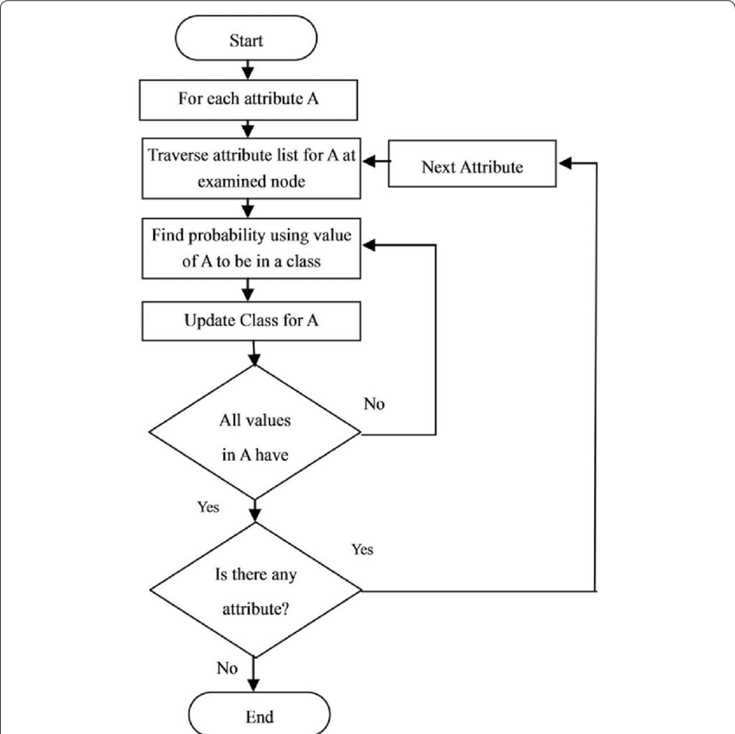
Machine Learning Models
4) Naïve Bayes:

Slide 52
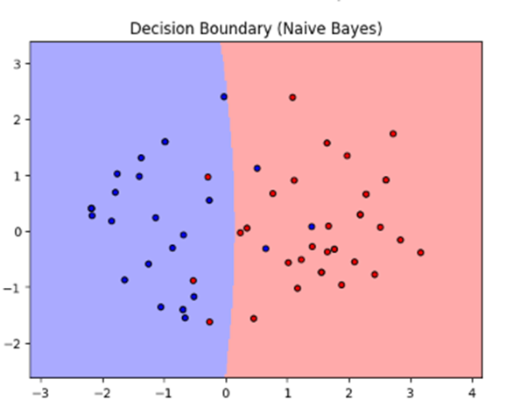
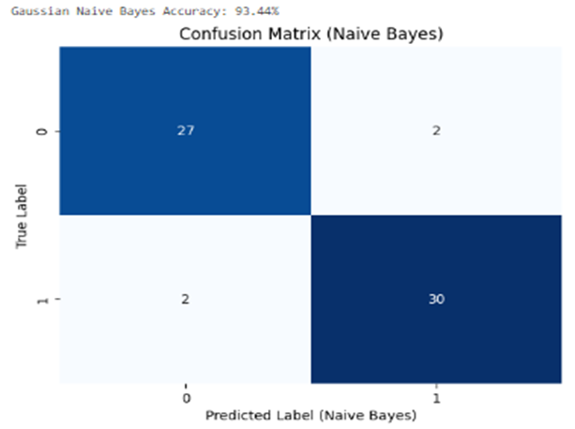
Machine Learning Models

Slide 53
Machine Learning Models
Why did we use Naïve Bayes Algorithm?
Simplicity and efficiency: Naive Bayes is a simple algorithm that requires minimal training data and computational resources, making it a good choice for initial analysis and quick insights.
Interpretability: The algorithm works based on conditional probabilities, making its predictions relatively easy to understand and interpret, which can be crucial in medical settings.
Handling categorical features: Naive Bayes can effectively handle categorical features without requiring complex preprocessing, which is often the case in datasets like the Heart Attack dataset.
Robustness to missing data: The algorithm can handle missing values without significant performance degradation, which might be helpful if the dataset has some missing entries.

Slide 54
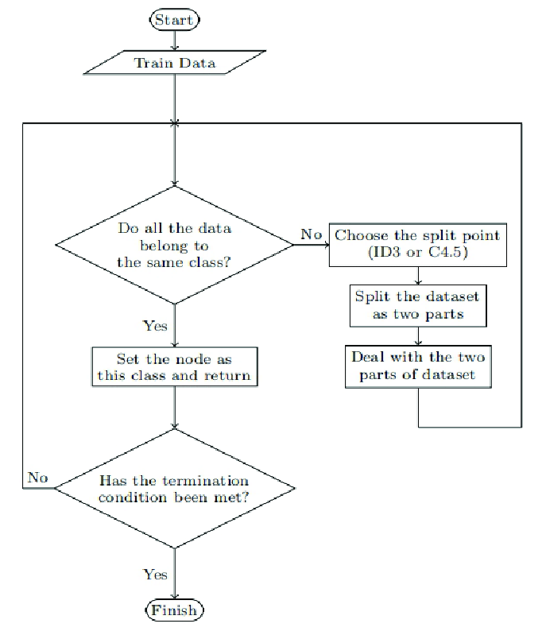
Machine Learning Models
5) Decision Trees:

Slide 55
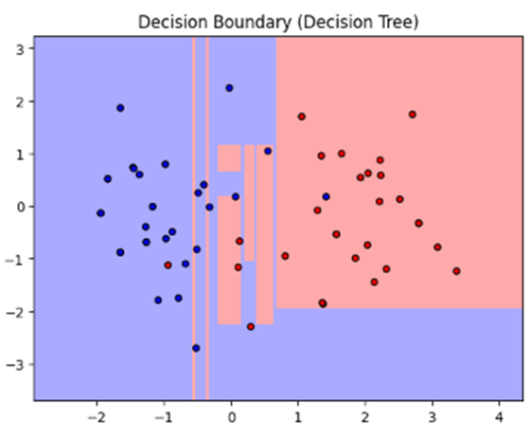
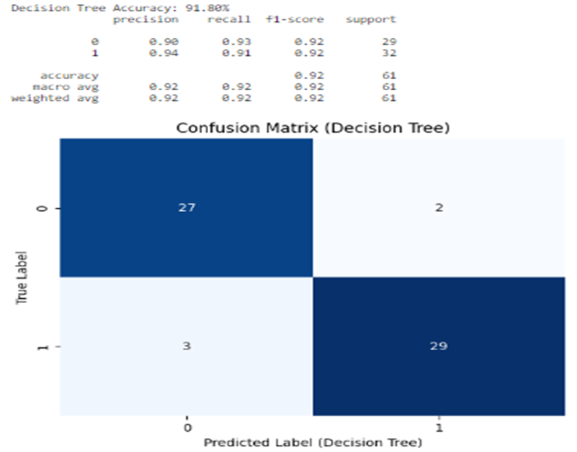
Machine Learning Models

Slide 56
Machine Learning Models
Why did we use Naïve Bayes Algorithm?
Because of its capacity to handle intricate, nonlinear interactions between several risk factors and the probability of a heart attack, the Decision Tree algorithm is used in the study and prediction of heart attack illness. It effectively divides data according to characteristics like blood pressure, cholesterol, age, and so on to create a tree-like model that medical experts can understand.
Non-linear relationships: Unlike linear models like linear regression, decision trees can capture and model non-linear relationships between features and the target variable (heart attack). This is important because the relationship between various risk factors and heart disease might not be strictly linear.
Feature importance: Decision trees inherently rank features based on their contribution to the prediction, offering insights into which factors are most important for identifying individuals at risk. This information can be valuable for both diagnosis and prevention efforts.
Interpretability: The decision-making process of a decision tree is relatively easy to understand, making it easier to interpret how the model arrives at its predictions. This can be crucial in medical settings where understanding the reasoning behind a prediction is essential.

Slide 57
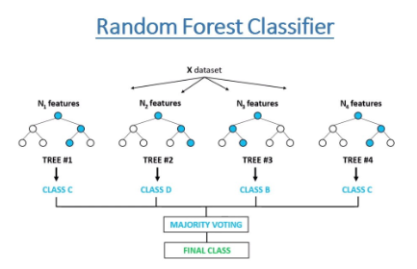
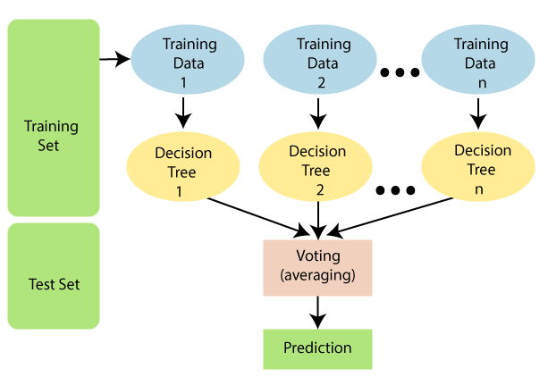
Machine Learning Models
6) Random Forest:

Slide 58
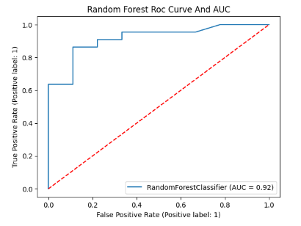
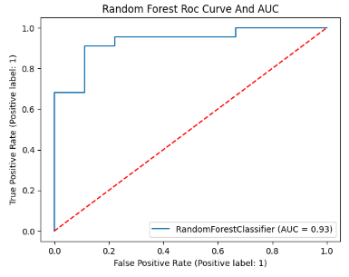
Machine Learning Models
Without Hyperparameter
With Hyperparameter

Slide 59
Machine Learning Models
Why did we use Random Forest Algorithm?
Non-linear relationships: Like decision trees, Random Forests can capture and model non-linear relationships between features and the target variable (heart attack). This is important because the relationship between various risk factors and heart disease might not be strictly linear.
Improved accuracy: By combining multiple decision trees through voting or averaging, Random Forests can significantly improve accuracy compared to individual decision trees. This makes them strong contenders for achieving high prediction performance.
Reduced overfitting: The randomness introduced during tree building helps prevent individual trees from overfitting to the training data, leading to better generalization on unseen data.
Feature importance: Similar to decision trees, Random Forests provide insights into feature importance, helping identify the most crucial factors for heart attack prediction.
Robustness: Random Forests are less susceptible to noise and outliers in the data compared to individual decision trees.

Slide 60
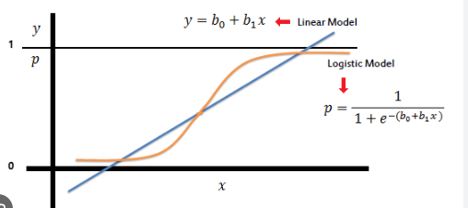
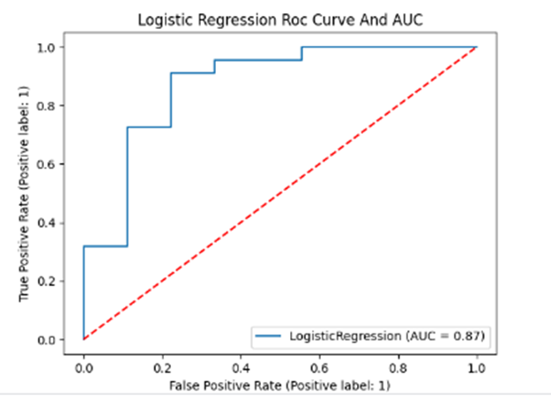
Machine Learning Models
7) Logistic Regression:
Parameter Name | Purpose | Value
Test size | To split the dataset into training and testing in a ratio | 0.2
Random State | This parameter sets the seed for the random number generator used by the data splitter. By using a fixed seed, the random splitting process becomes deterministic, allowing for result reproducibility. | 3
Without using Hyperparameter

Slide 61
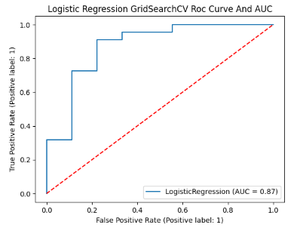
Machine Learning Models
Parameter Name | Purpose | Value
Test size | To split the dataset into training and testing in a ratio | 0.2
Random State | This parameter sets the seed for the random number generator used by the data splitter. By using a fixed seed, the random splitting process becomes deterministic, allowing for result reproducibility. | 3
Grid Search | The grid search explores various alpha values using 5-fold cross-validation. | "penalty":["l1","l2"], "solver" : ['newton-cg', 'lbfgs', 'liblinear', 'sag', 'saga']
7) Logistic Regression:
With using Hyperparameter

Slide 62
Machine Learning Models
Why did we use Logistic Algorithm?
Logistic Regression requires less training data compared to complex models like neural networks. This can be beneficial if the Heart Attack dataset is relatively small or contains missing values.
While not always the most accurate, Logistic Regression can achieve good performance on this dataset, especially for initial analysis and identifying important features.
It serves as a good baseline model to compare the performance of more complex models, helping you evaluate if the added complexity is justified.
You can easily interpret the weights assigned to each feature, providing insights into which factors are most predictive of heart attack risk. This information can be valuable for both diagnosis and prevention efforts.

Slide 63
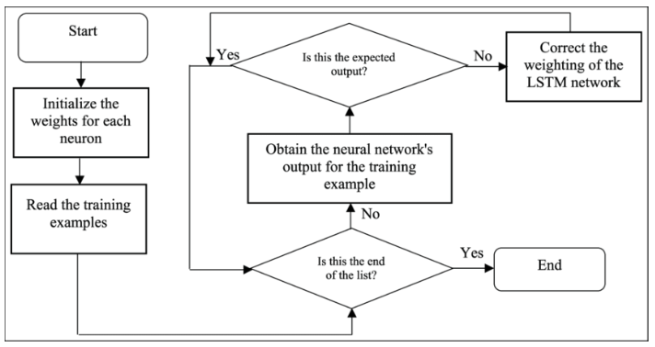
Deep Learning Models
1) LSTM:

Slide 64
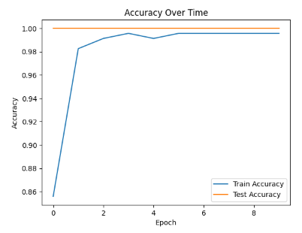
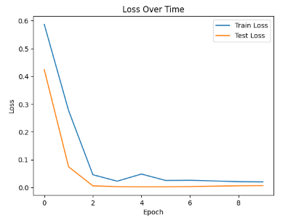
Deep Learning Models
1) LSTM:
Without Hyper Parameter

Slide 65
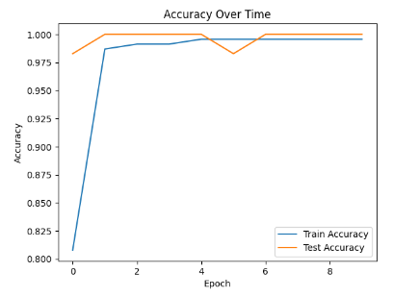
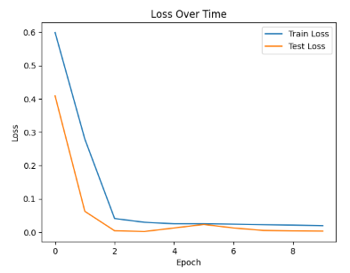
Deep Learning Models
1) LSTM:
With Hyper Parameter

Slide 66
Deep Learning Models
1) LSTM:
Sr. No. | Parameters | Value
1 | Epochs | 10
2 | Accuracy | 94.21%
3 | Training Loss | 0.0228
4 | Validation Accuracy | 98.28%
5 | Validation Loss | 0.0597
6 | Testing Accuracy | 91.3275%
7 | Batch Size | 32
8 | Loss | binary_crossentropy
9 | Optimizer | adam
10 | Activation Function | Sigmoid
11 | LSTM Unit | 100
12 | Learning rate | 0.001
13 | Test size | 0.2
14 | Precision, recall, f1-score | 0.98,0.98,0.98
15 | LSTM Units | 100
With Hyper Parameter tuning

Slide 67
Deep Learning Models
Why did we use LSTM?
The intuition behind the LSTM architecture is to create an additional module in a neural network that learns when to remember and when to forget pertinent information. In other words, the network effectively learns which information might be needed later on in a sequence and when that information is no longer needed.
LSTMs can learn complex representations of the data by capturing long-term dependencies, which might be beneficial if the relationships between features and heart attack risk are inherently sequential or involve time-lagged effects. However, carefully assess the interpretability and generalizability of these learned features, especially with limited data.
LSTMs can model dynamic changes in patient data over time, which could be useful if the dataset includes longitudinal measurements or if the risk of heart attack evolves over time. Ensure the data captures such dynamics and that the model is robust to potential inconsistencies or missing values in the sequences.

Slide 68
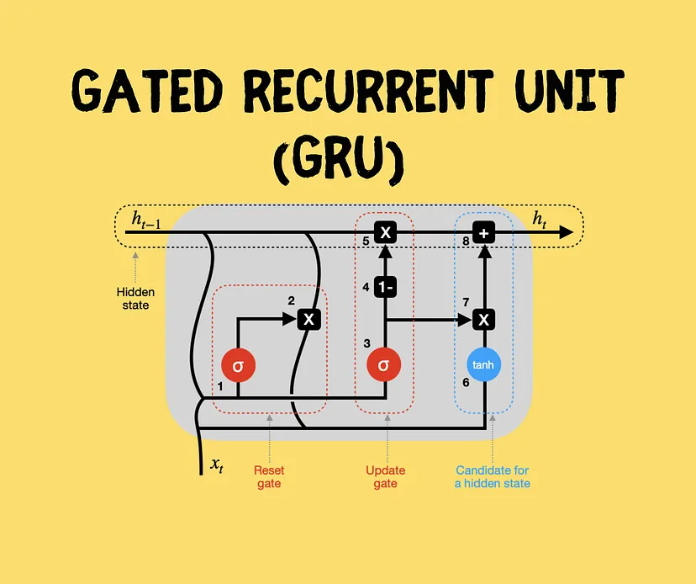
Deep Learning Models
2) GRU:

Slide 69
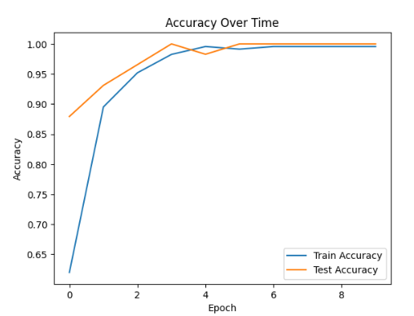
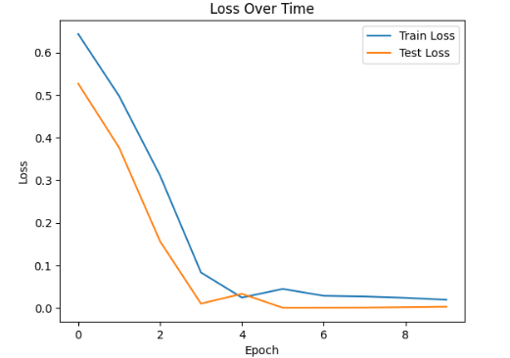
Deep Learning Models
2) GRU:
Without Hyper Parameter

Slide 70
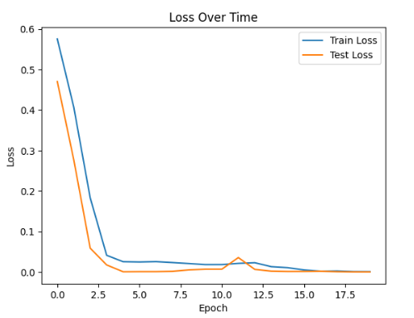
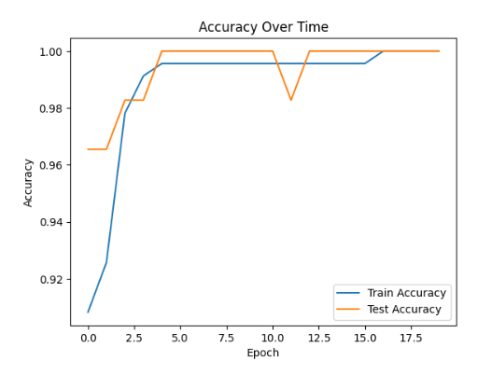
Deep Learning Models
2) GRU:
With Hyper Parameter

Slide 71
Deep Learning Models
2) GRU:
Sr. No. | Parameters | Value
1 | Epochs | 20
2 | Accuracy | 96.41%
3 | Training Loss | 0.000134
4 | Validation Accuracy | 94.28%
5 | Validation Loss | 0.1243
6 | Testing Accuracy | 94.2758%
7 | Batch Size | 32
8 | Loss | binary_crossentropy
9 | Optimizer | adam
10 | Activation Function | Sigmoid
11 | GRU Unit | 100
12 | Learning rate | 0.001
13 | Test size | 0.2
14 | Precision, recall, f1-score | 0.98,0.98,0.98
15 | GRU Units | 100
With Hyper Parameter tuning

Slide 72
Deep Learning Models
Why did we use GRU?
GRU (Gated Recurrent Unit) is chosen for heart attack analysis and prediction due to its effectiveness in modeling sequential data.
It addresses vanishing gradient problems encountered in traditional RNNs, making it suitable for capturing long-term dependencies in time series data like electrocardiograms (ECG) or patient records.
GRU incorporates gating mechanisms to regulate information flow, enabling it to discern subtle patterns and changes over time that may precede a heart attack event.
Compared to LSTM (Long Short-Term Memory), GRU requires fewer parameters, making it computationally more efficient for real-time applications or large datasets.
GRU's architecture facilitates faster training and inference times, which is beneficial for deploying predictive models in clinical settings where prompt decision-making is crucial.
Overall, GRU's efficiency and effectiveness in handling sequential data make it a valuable tool for heart attack analysis and prediction tasks.

Slide 73
Explainable AI Algorithms
Local vs. Global Explanations:
Local methods: Explain individual predictions by focusing on the specific data instance and how it led to the outcome. Examples:
LIME (Local Interpretable Model-Agnostic Explanations): Creates simple, interpretable models around individual predictions to explain them.
SHAP (SHapley Additive exPlanations): Assigns feature importance scores based on their contribution to the prediction.
Anchors: Identify a minimal set of features sufficient for making the same prediction.
Global methods: Explain the overall behavior of the model across all predictions. Examples:
Permutation importance: Randomly shuffles features to see how much the model's performance changes, indicating feature importance.
Partial dependence plots (PDPs): Show how the model's prediction changes in response to a single feature while holding others constant.
Integrated gradients: Explain the model's prediction by attributing importance to the input features along the path to the output.
Model-Agnostic vs. Model-Specific methods:
Model-agnostic methods: Work with any model, regardless of its internal workings. Examples: LIME, SHAP, Anchors, permutation importance, PDPs.
Model-specific methods: Leverage the specific architecture or training process of a model for explanations. Examples:
Layer-wise relevance propagation (LRP): Propagates relevance scores back through the layers of a neural network to explain its output.
Attention mechanisms: Highlight the parts of the input that a model focuses on for making a prediction (common in transformers).

Slide 74
Explainable AI Algorithms
Initial analysis and feature importance:
Start with a simple model like Logistic Regression and use model-agnostic methods like LIME, SHAP, or PDPs to understand how features contribute to individual predictions and overall model behavior.
Deeper exploration and complex models:
If you need more insights or are using complex models, explore model-specific methods like LRP or attention mechanisms along with global methods like permutation importance or integrated gradients.
Specific algorithm recommendations:
LIME: Great for explaining individual predictions with simple models.
SHAP: Offers feature importance scores and explanations for various models.
PDPs: Visualize how the model's prediction changes with a single feature.
LRP: Explains predictions in neural networks by attributing importance to input features.

Slide 75
Explainable AI Algorithms
Why should we use LIME algorithm?
LIME excels at explaining why a specific patient was predicted to have a heart attack and identifying the key features contributing to that prediction. This can be valuable for understanding the model's reasoning in individual cases and potentially flagging potential biases.
LIME works with any model type, regardless of its internal workings. This makes it versatile and applicable to various models you might use for the Heart Attack dataset (e.g., Logistic Regression, Random Forests, etc.).
LIME generates explanations in the form of simple, human-readable models like linear regressions or decision trees. This makes them easier to understand compared to the inner workings of complex models.
Alternative Algorithms:
SHAP (SHapley Additive exPlanations): Provides feature importance scores and explanations for various models, offering both local and global insights.
PDPs (Partial Dependence Plots): Visualize how the model's prediction changes with a single feature while holding others constant, offering global understanding.
Anchors: Identify a minimal set of features sufficient for making the same prediction, providing concise explanations.

Slide 76
Explainable AI Algorithms
Why should we use LRP algorithm?
If we are using a neural network model for the Heart Attack dataset, LRP offers deep insights by attributing importance to input features throughout the network's layers. This can help you understand how different parts of the network contribute to the final prediction, providing a more nuanced explanation compared to model-agnostic methods.
LRP can generate heatmaps or saliency maps that visually highlight the regions in the input data most relevant to the prediction. This can be helpful for understanding which parts of an image or other data are driving the model's decision, potentially revealing subtle patterns or correlations.
LRP's explanations are based on attributing relevance scores, which can be easier to understand compared to the inner workings of other deep learning techniques. This helps bridge the gap between the complex calculations of the model and your human understanding.

Slide 77
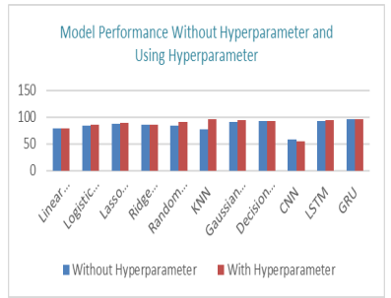
Results
Fig 1. Model Performance with and without Hyperparameter Tuning

Slide 78
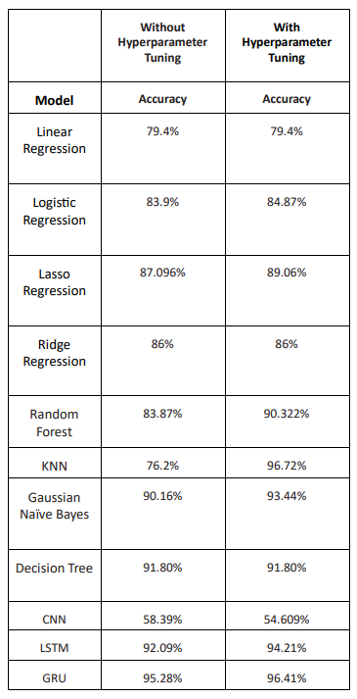
Results
Table 1. Accuracy of Model

Slide 79
Results
Table 1 illustrates the accuracy of 86% obtained using Ridge Regression on the dataset without hyperparameter tweaking. But as Table 1 shows, when hyperparameter modification was included, Accuracy unchanged.
Table 1 illustrates the results of Logistic Regression without hyperparameter adjustment, which had an accuracy of 83.9% and the accuracy after hyperparameter modification was 84.87%.
The accuracy of the random forest model increased from 83.87% to 90.32% after hyperparameter tuning.
As can be seen in Table 1, the accuracy of the LSTM and GRU results without hyperparameter modification are 92.09% and 95.28%, and the accuracy increased to 94.21% and 96.41% after hyperparameter adjustment.

Slide 80
Results
With a 96.41% accuracy rate, GRU is demonstrated to have the biggest improvement following hyperparameter tweaking. But only CNN was shown to show a drop in accuracy following hyperparameter tweaking, as Table 1 illustrates.

Slide 81
Conclusion and Future Works
Early diagnosis significantly improves prognosis and quality of life for individuals with cardiac issues through lifestyle modifications, medical interventions, and prompt care, mitigating the impact of heart attacks.
This study utilized various data analysis techniques to identify heart attack risks based on relevant variables, employing thorough data processing to eliminate duplicates and inconsistencies.
Classification techniques were employed, both with and without hyperparameter adjustment, to predict cardiac attacks. Among these, KNN demonstrated the highest accuracy at 96.72%.
Future research aims to enhance model generalizability by expanding to larger datasets encompassing diverse clinical circumstances and demographics. This includes exploring advanced machine learning methods like deep learning algorithms for improved prediction capabilities.
To refine heart attack risk prediction, consideration will be given to incorporating new characteristics or factors. Collaboration with medical professionals and institutions is essential to validate and align the approach with clinical practices.
The scope of future endeavors involves developing a comprehensive early detection system, potentially integrating other imaging and physiological data to create a more holistic approach to cardiac risk assessment.

Slide 82
References
[1] S. Yang, C. Lian, Z. Zeng, B. Xu, J. Zang, and Z. Zhang, “A multi-view multi-scale neural network for multi-label ECG classification,” IEEE Trans. Emerg. Top. Comput. Intell., vol. 7, no. 3, pp. 648–660, 2023.
[2] R. Bharti, A. Khamparia, M. Shabaz, G. Dhiman, S. Pande, and P. Singh, “Prediction of heart disease using a combination of machine learning and deep learning,” Comput. Intell. Neurosci., vol. 2021, pp. 1–11, 2021.
[3] K. V. V. Reddy, I. Elamvazuthi, A. A. Aziz, S. Paramasivam, H. N. Chua, and S. Pranavanand, “Heart disease risk prediction using machine learning classifiers with attribute evaluators,” Appl. Sci. (Basel), vol. 11, no. 18, p. 8352, 2021.
[4] S. Hasbullah, M. S. Mohd Zahid, and S. Mandala, “Detection of myocardial Infarction using hybrid models of convolutional Neural Network and recurrent Neural Network,” BioMedInformatics, vol. 3, no. 2, pp. 478–492, 2023.
[5] K. Prajwal, Tharun, Navaneeth, and A. Kumar, “Cardiovascular disease prediction using machine learning,” in 2022 International Conference on Innovative Trends in Information Technology (ICITIIT), 2022.
[6] R. R. Kamireddy and N. Darapureddy, “A machine learning-based approach for the prediction of cardiovascular diseases,” in The 4th International Electronic Conference on Applied Sciences, 2023.
[7] A. Lakshmanarao, A. Srisaila, and T. S. R. Kiran, “Heart disease prediction using feature selection and ensemble learning techniques,” in 2021 Third International Conference on Intelligent Communication Technologies and Virtual Mobile Networks (ICICV), 2021.

Slide 83
References
[8] P. Xiong, S. M.-Y. Lee, and G. Chan, “Deep learning for detecting and locating myocardial infarction by electrocardiogram: A literature review,” Front. Cardiovasc. Med., vol. 9, 2022.
[9] E. Choi, A. Schuetz, W. F. Stewart, and J. Sun, “Using recurrent neural network models for early detection of heart failure onset,” J. Am. Med. Inform. Assoc., vol. 24, no. 2, pp. 361–370, 2017.
[10] F. Goretti, B. Oronti, M. Milli, and E. Iadanza, “Deep learning for predicting congestive heart failure,” Electronics (Basel), vol. 11, no. 23, p. 3996, 2022.
[11] J. Zang, J. Wang, Z. Zhang, Y. Zheng, and C. Xue, “Improving ECG classification performance by using an optimized one-dimensional residual network model,” Appl. Sci. (Basel), vol. 12, no. 24, p. 12957, 2022.

Slide 84

Litmap

Slide 85

THANK YOU

